Slide 1
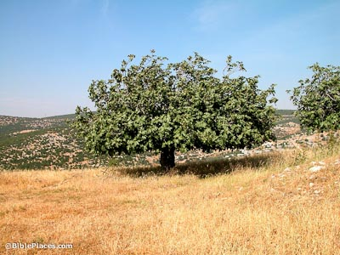
John 1.35-51
Photo of a fig tree in Israel
courtesy of BiblePlaces.com

Slide 2
John 1.35-37 [NET]: Again the next day John was standing there with two of his disciples. Gazing at Jesus as he walked by, he said,
“Look, the Lamb of God!” When John’s two disciples heard him say this, they followed Jesus.

Slide 3
John 1.35-37 [NET]: Again the next day John was standing there with two of his disciples. Gazing at Jesus as he walked by, he said,
“Look, the Lamb of God!” When John’s two disciples heard him say this, they followed Jesus.

Slide 4
John 1.38-39: Jesus turned around and saw them following and said to them, “What do you want?”
So they said to him, “Rabbi” (which is translated
Teacher),
“where are you staying?” Jesus answered, “Come and you will see.” So they came and saw where he was staying, and they stayed with him that day. Now it was about four o’clock in the afternoon.

Slide 5
John 1.38-39: Jesus turned around and saw them following and said to them, “What do you want?”
So they said to him, “Rabbi” (which is translated
Teacher),
“where are you staying?” Jesus answered, “Come and you will see.” So they came and saw where he was staying, and they stayed with him that day. Now it was about four o’clock in the afternoon.

Slide 6
John 1.40-42: Andrew, the brother of Simon Peter, was one of the two disciples who heard what John said and followed Jesus. He first found his own brother Simon
and told him, “We have found the Messiah!” (which is translated Christ). Andrew brought Simon to Jesus. Jesus looked at him and said, “You are Simon, the son of John. You will be called Cephas” (which is translated Peter).

Slide 7
John 1.40-42: Andrew, the brother of Simon Peter, was one of the two disciples who heard what John said and followed Jesus. He first found his own brother Simon
and told him, “We have found the Messiah!” (which is translated Christ). Andrew brought Simon to Jesus. Jesus looked at him and said, “You are Simon, the son of John. You will be called Cephas” (which is translated Peter).

Slide 8
John 1.40-42: Andrew, the brother of Simon Peter, was one of the two disciples who heard what John said and followed Jesus. He first found his own brother Simon
and told him, “We have found the Messiah!” (which is translated Christ). Andrew brought Simon to Jesus. Jesus looked at him and said, “You are Simon, the son of John. You will be called Cephas” (which is translated Peter).

Slide 9
John 1.43-46: On the next day Jesus wanted to set out for Galilee. He found Philip and said to him, “Follow me.” (Now Philip was from Bethsaida, the town of Andrew
and Peter.) Philip found Nathanael and told him, “We have found the one Moses wrote about in the law, and the prophets also wrote about—Jesus of Nazareth, the son of Joseph.” Nathanael replied, “Can anything good come out of Nazareth?” Philip replied, “Come and see.”

Slide 10
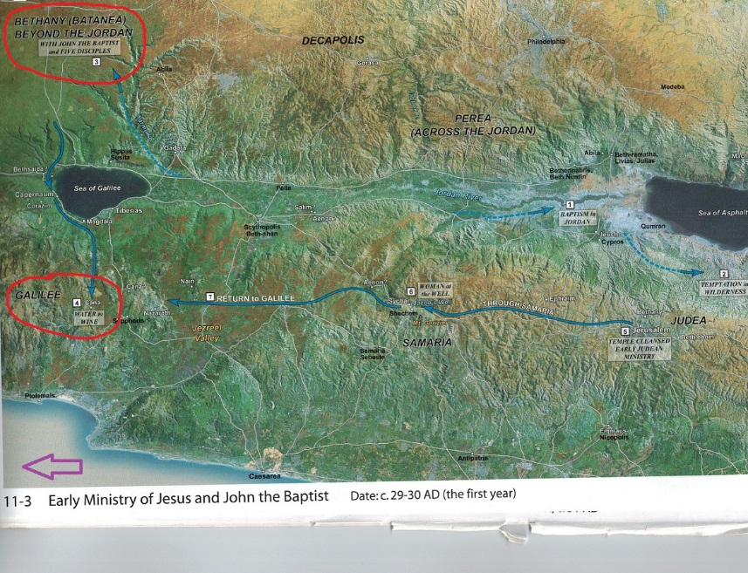
Map by Bill Schlegel
Satellite Bible Atlas Prototype B; #11-3

Slide 11
John 1.43: On the next day Jesus wanted to set out for Galilee. He found Philip and said to him, “Follow me.”

Slide 12
John 1.44-46: Philip found Nathanael and told him, “We have found the one Moses wrote about in the law, and the prophets also wrote about—Jesus of Nazareth,
the son of Joseph.” Nathanael replied, “Can anything good come out of Nazareth?” Philip replied, “Come and see.”

Slide 13
Deuteronomy 18.15-19 [NET]: The Lord your God will raise up for you a prophet like me from among you—from your fellow Israelites; you must listen to him. This accords with what happened at Horeb in the day of the assembly. You asked the Lord your God: “Please do not make us hear the voice of the Lord our God any more or see this great fire any more lest we die.” The Lord then said to me, “What they have said is good. I will raise up a prophet like you for them from among their fellow Israelites. I will put my words in his mouth and he will speak to them whatever I command. I will personally hold responsible anyone who then pays no attention to the words that prophet speaks in my name.”

Slide 14
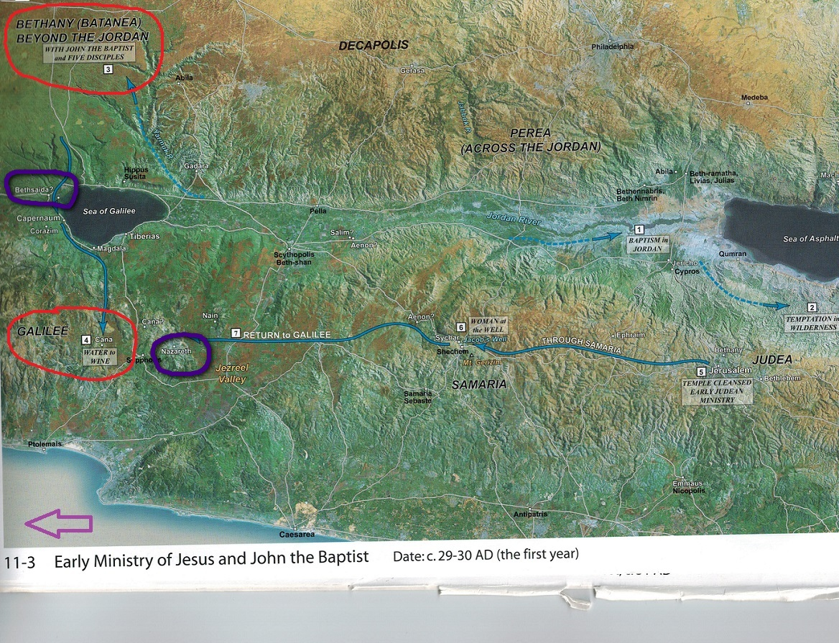
John 1.46: Nathanael replied, “Can anything good come out of Nazareth?” Philip replied, “Come and see.”

Slide 15
John 1.47-49: Jesus saw Nathanael coming toward him and exclaimed, “Look, a true Israelite in whom there is no deceit!” Nathanael asked him, “How do you know me?”
Jesus replied, “Before Philip called you, when you were under the fig tree, I saw you.” Nathanael answered him, “Rabbi, you are the Son of God; you are the king of Israel!”

Slide 16
John 1.50-51: Jesus said to him, “Because I told you that I saw you under the fig tree, do you believe? You will see greater things than these.”
He continued, “I tell all of you the solemn truth—you will see heaven opened and the angels of God ascending and descending on the Son of Man.”

Slide 17
Micah 4:1-4 NIV: In the last days the mountain of the LORD's temple will be established as the highest of the mountains; it will be exalted above the hills, and peoples will stream to it. Many nations will come and say, “Come, let us go up to the mountain of the LORD, to the temple of the God of Jacob. He will teach us his ways, so that we may walk in his paths.” The law will go out from Zion, the word of the LORD from Jerusalem. He will judge between many peoples and will settle disputes for strong nations far and wide. They will beat their swords into plowshares and their spears into pruning hooks. Nation will not take up sword against nation, nor will they train for war anymore. Everyone will sit under their own vine and under their own fig tree, and no one will make them afraid, for the LORD Almighty has spoken.

Slide 18
Zechariah 3.8-10 NIV: “Listen, High Priest Joshua, you and your associates seated before you, who are men symbolic of things to come: I am going to bring my servant, the Branch. See, the stone I have set in front of Joshua! There are seven eyes on that one stone, and I will engrave an inscription on it,” says the LORD Almighty, “and I will remove the sin of this land in a single day. In that day each of you will invite your neighbor to sit under your vine and fig tree,” declares the LORD Almighty.

Slide 19
John 1.50-51: Jesus said to him, “Because I told you that I saw you under the fig tree, do you believe? You will see greater things than these.”
He continued, “I tell all of you the solemn truth—you will see heaven opened and the angels of God ascending and descending on the Son of Man.”

Slide 20
John 1.50-51: Jesus said to him, “Because I told you that I saw you under the fig tree, do you believe? You will see greater things than these.”
He continued, “I tell all of you the solemn truth—you will see heaven opened and the angels of God ascending and descending on the Son of Man.”

Slide 21
Daniel 7.13-14 NIV: In my vision at night I looked, and there before me was one like a son of man, coming with the clouds of heaven. He approached the Ancient of Days and was led into his presence. He was given authority, glory and sovereign power; all nations and peoples of every language worshiped him. His dominion is an everlasting dominion that will not pass away, and his kingdom is one that will never be destroyed.

Slide 22
Genesis 28.12-15 NIV: He had a dream in which he saw a stairway resting on the earth, with its top reaching to heaven, and the angels of God were ascending and descending on it. There above it stood the LORD, and he said: “I am the LORD, the God of your father Abraham and the God of Isaac. I will give you and your descendants the land on which you are lying. Your descendants will be like the dust of the earth, and you will spread out to the west and to the east, to the north and to the south. All peoples on earth will be blessed through you and your offspring. I am with you and will watch over you wherever you go, and I will bring you back to this land. I will not leave you until I have done what I have promised you.

Slide 23
Lamb of God
Rabbi/Teacher
Greater Moses Prophet
Ultimate Davidic King
Eternal High Priest / Mediator
Son of Man
Who is Jesus?

Slide 24
Know what you are seeking
Actively seek by following
 be willing to be transformed
 get teaching/training
Share the good news of Jesus
How should you respond?

Slide 25
